Slide 1
Financial Caretaking
Proactive aging strategies for preventing financial abuse and preparing for the transition of financial decision-making authority.

Slide 2
Introduction
What is financial caretaking?
Why proactively plan
Creating a financial caretaking plan
Screening to identify issues managing finances

Slide 3
What is Financial Caretaking?

Slide 4
Definition
Financial caretaking is the process caring for the finances of someone else, usually by a younger family member on behalf of an older family member.

Slide 5
Financial caretaking is increasingly prevalent
According to a major study by Merrill Lynch*
The are roughly 40 million caregivers in the US
92% of caregivers are “financial caregivers”
88% are "financial coordinators“, i.e., pay bills, monitor accounts, file taxes, etc.
68% are “financial contributors”, i.e., provide financial support
66% of caregivers said they'd benefit from financial advice
*The Journey of Caregiving, November 2017

Slide 6
Why Proactively Plan?

Slide 7
Ensure safe, open and orderly financial transitions
Openness and transparency keeps everyone on the same page, lowers risk of family disagreements
Having multiple people involved reduces risk of fraud and abuse
Process helps ensure that financial wishes are carried out

Slide 8
Aging is not predictable
People age differently
Untoward events, illnesses, injuries, medications can all accelerate the process
Bad decisions are more likely during periods of stress or emotional instability (e.g., following the loss of a spouse)

Slide 9
Cognitive changes are sneaky
As we age, our brain loses flexibility
Thinking may become more concrete
Harder to wire new memories
Dementia can set in as early as age 60, and its frequency doubles every 5 years after that
Cognitive and behavioral changes can happen rapidly

Slide 10
Risk of fraud and abuse
Older adults tend to
Be more trusting - harder to imagine being bilked
Have difficulty “connecting the dots”
Be more susceptible and reactive to fear
Have more difficulty focusing attention
Be more impulsive

Slide 11
Widespread nature of fraud and abuse
$17 billion lost annually to financial exploitation
2/3 due to criminal fraud
1/3 due to abuse by caregivers
Perpetrators
Family, friends, neighbors – 75%
Home care aids – 15%
Others – 10%

Slide 12
Tricking the brain to do the right thing
Proactive planning takes you through likely scenarios
When you are well and not under duress, you are more likely to make good decisions
By creating a plan and revisiting it periodically, the plan becomes hard wired in your long term memory
When “bad things” happen, you are more likely to revert to the plan hard wired in your brain

Slide 13
Creating a Financial Caretaking Plan

Slide 14
When to start
By early 50s - according to a major study, financial decision-making capacity peaks on average at age 53
Triggers for financial caretaking
Normal aging
Accident
Illness
Death of a spouse
Are you ready for someone to take over?

Slide 15
How to prepare
List of all financial assets
How to access accounts
Location of important documents
Assignment of trusted caretaker responsibilities (bill pay, investment management, etc.)
Management of investments and estate
Pet and child care

Slide 16
Whealthcare Financial Caretaking Plan overview
Complete a 15 minute questionnaire
Documents what you are doing now and what you would like to have happen in the future
Identifies a list of the “holes” in your plan
Generates a comprehensive plan to fix the holes
Provides supporting tools and education

Slide 17
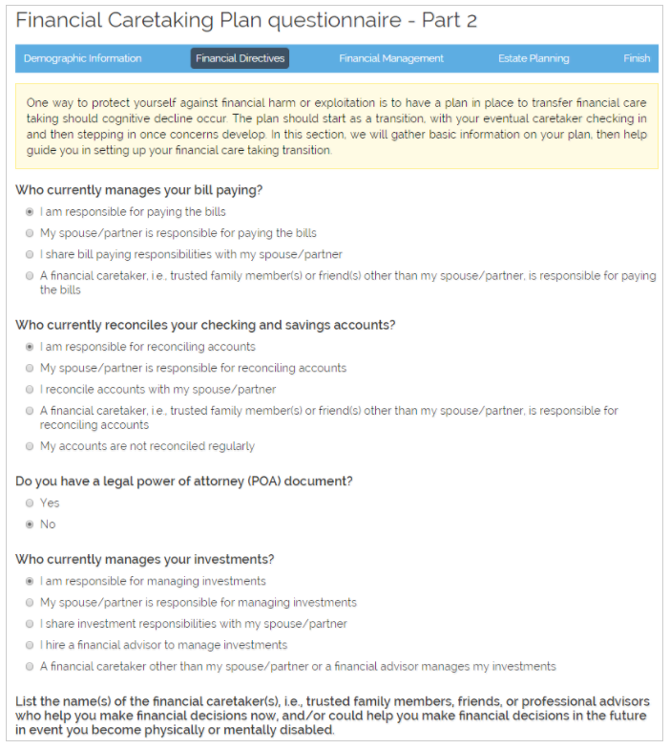
Whealthcare Financial Caretaking Plan questionnaire

Slide 18
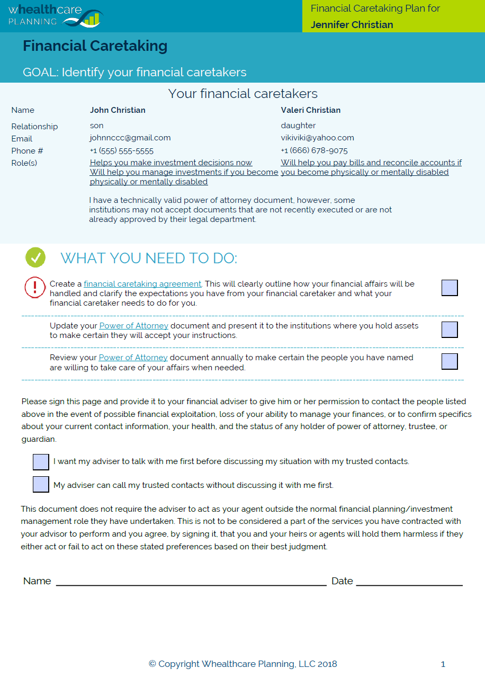
Whealthcare Financial Caretaking Plan report

Slide 19

Whealthcare Education Academy

