Slide 1
Keys to Successful Proactive Aging
Planning for the Big Four Transitions – Financial Decision-making, Health Care Decision-making, Living, and Driving

Slide 2
Introduction
Why proactively plan for aging?
The “Big Four” transitions
Financial decision-making
Health care decision making
Living
Driving

Slide 3
Why Proactively Plan?

Slide 4
Aging Is Not Predictable
People age differently
Untoward events accelerate the process
Bad decisions are more likely when under stress

Slide 5
Cognitive Changes Are Sneaky
As we age, our brain loses flexibility
Thinking may become more concrete
Harder to wire new memories

Slide 6
Tricking The Brain To Do The Right Thing
Proactive planning takes you through likely scenarios
When you are well and not under duress, you are more likely to make good decisions
By creating a plan and revisiting it periodically, the plan becomes hard wired in your long term memory
When “bad things” happen, you are more likely to revert to the plan hard wired in your brain

Slide 7
Now The Big Four

Slide 8
#1 Financial Decision-making Transitions

Slide 9
Who Pays The Bills? Who Manages The Investments?
Triggers for financial caretaking
Accidents
Illness
Normal aging
Are you ready for someone to take over?

Slide 10
How To Prepare
List of all financial assets
How to access accounts
Location of important documents
Management of investments
Pet and child care

Slide 11
Whealthcare Financial Caretaking Plan
Complete a 15 minute questionnaire
Documents what you are doing now
Identifies a list of the “holes” in your plan
Provides tools and education to fix the holes

Slide 12
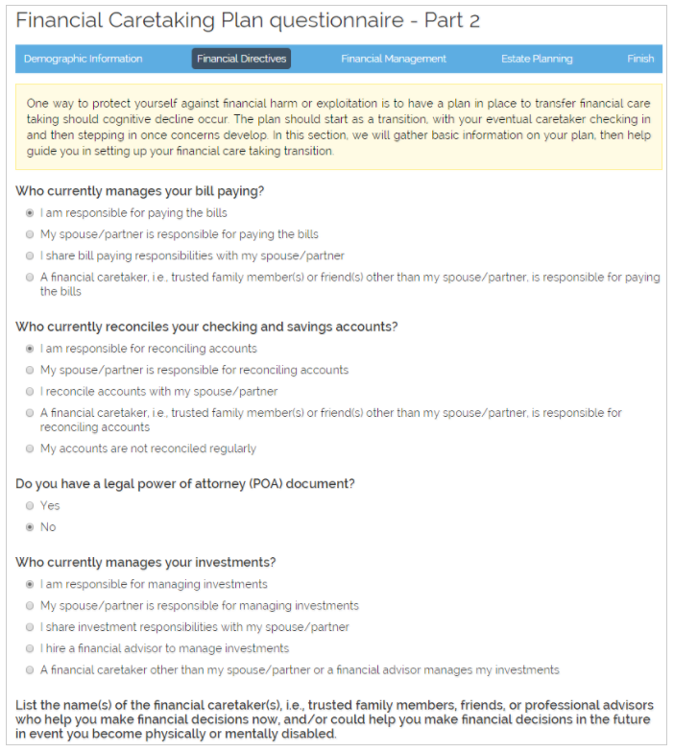
Whealthcare Financial Caretaking Plan - Questionnaire

Slide 13
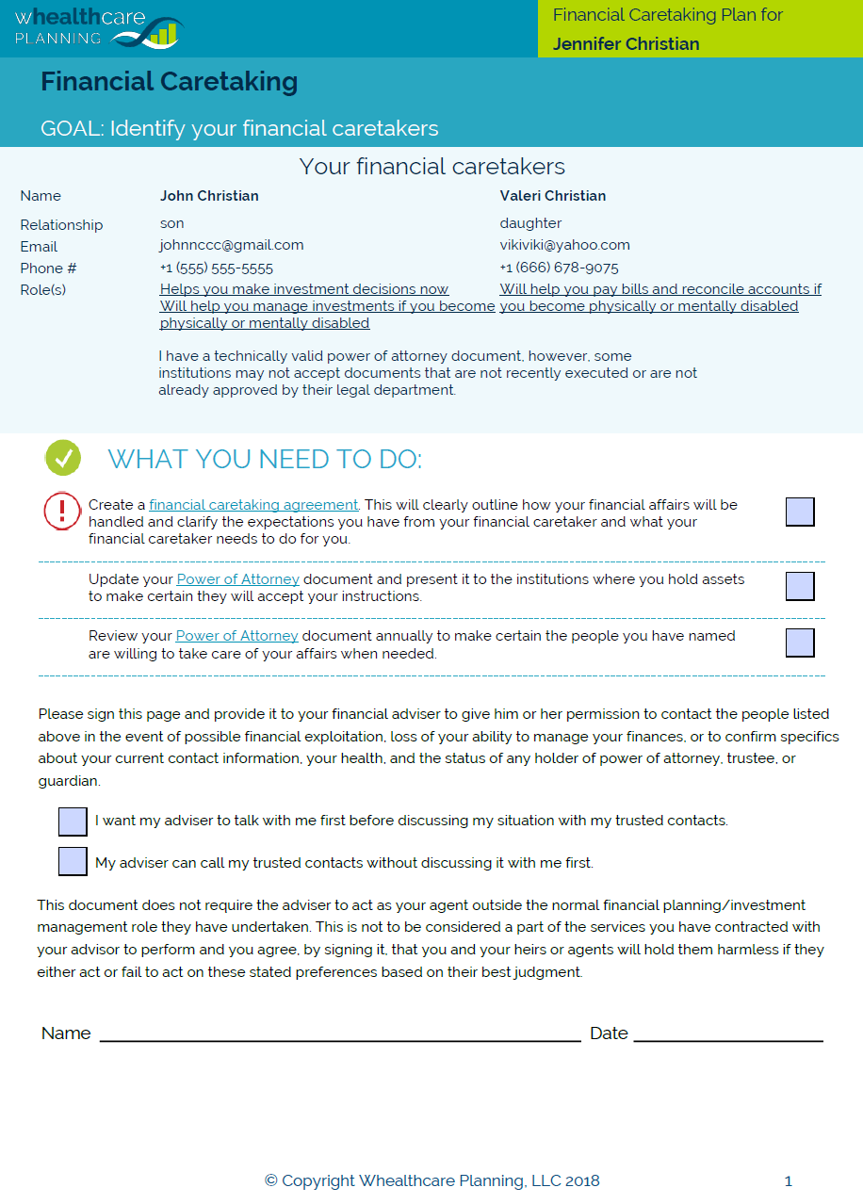
Whealthcare Financial Caretaking Plan - Report

Slide 14
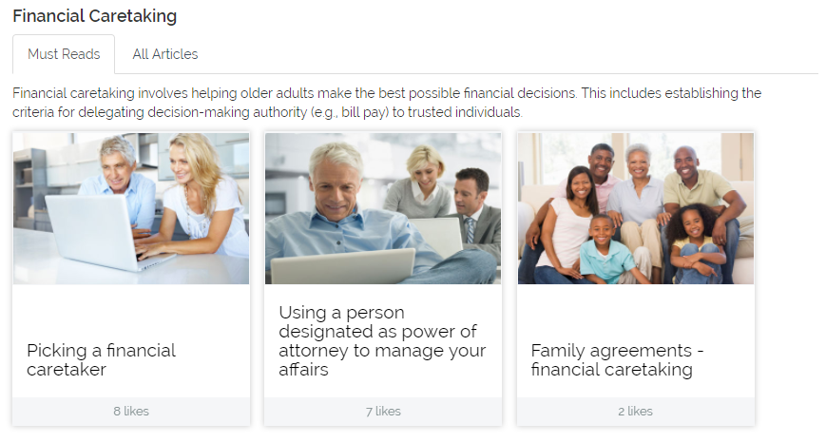
Whealthcare Financial Caretaking -Education

Slide 15
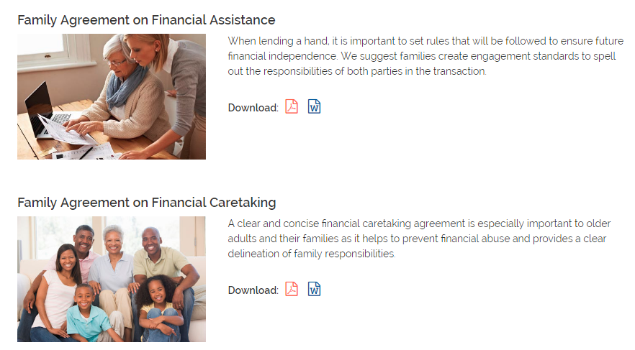
Whealthcare Financial Caretaking -Sample Documents

Slide 16
When To Make The Switch
When do you turn over financial care taking?
When you think it is a problem?
When your family thinks it is a problem?
How about when objective testing identifies there could be a problem?

Slide 17
Using the Whealthcare Risk Profile
A 15 minute questionnaire that identifies
Behaviors that put you at risk of fraud and abuse
Cognitive issues around financial decision making
Basic financial literacy
!! The risk profile is not a test for dementia!!

Slide 18
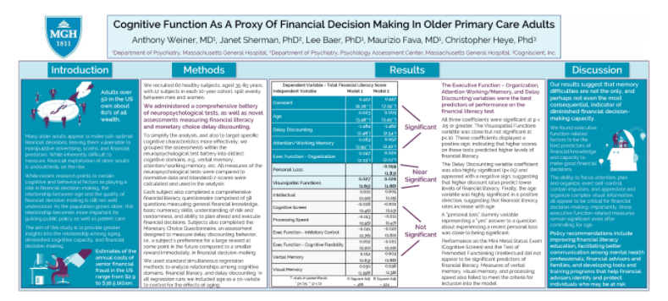
Whealthcare Risk Profile – Clinical Foundations
Based on a clinical study completed at Massachusetts General Hospital

Slide 19
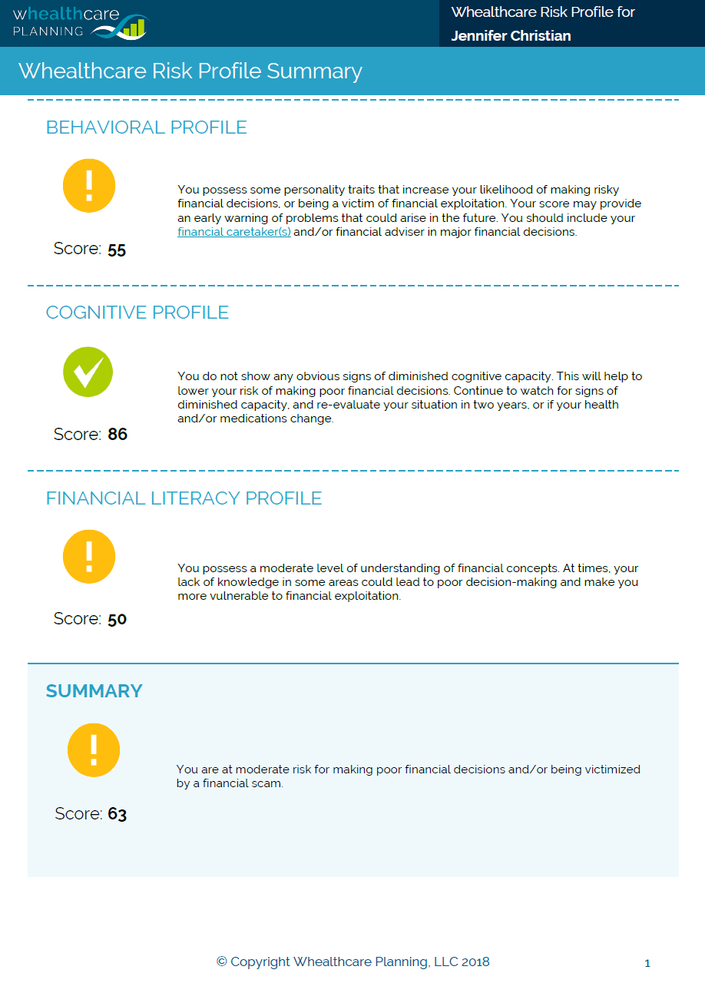
Whealthcare Risk Profile – Report

Slide 20
Whealthcare Risk Profile – Behavioral Profile
Green is good
Yellow – you have an issue
Need education on better behaviors to protect yourself – provided in the Whealthcare report
Red – you have a major issue
Need education
Consider putting protection in place

Slide 21
Whealthcare Risk Profile – Cognitive Screen
Green is good
Yellow – you have an issue
Time to consider turning over financial care taking
May be having
Normal aging
Medical issue
Early dementia
See a doctor for further testing!
Red – the issue would be obvious

Slide 22
Whealthcare Risk Profile – Financial Literacy
Green is good
Yellow or red – you have an issue
People with good financial literacy can maintain control of their finances longer
Get education!

Slide 23
#2 Living Transitions

Slide 24
Proactive Not Reactive Planning
Living transitions are often abrupt
Accident/illness puts elder in rehab
Family realizes no longer safe to live alone
Homes are often not aging friendly
Dementia is insidious – hard to make decisions about living transitions once it has set in
Scrambling is a set up for poor decisions and increased cost

Slide 25
Proactive Not Reactive Planning
Living transitions are often abrupt
Accident/illness puts elder in rehab
Family realizes no longer safe to live alone
Homes are often not aging friendly
Dementia is insidious – hard to make decisions about living transitions once it has set in
Scrambling is a set up for poor decisions and increased cost

Slide 26
#3 Health Care Decision-making Transitions

Slide 27
The Challenge Of Health Care Decisions
Illness makes it tough to think clearly
The health care system is geared toward action when less action may be the better choice
Family dynamics may worsen the situation

Slide 28
Proactive Not Reactive Planning
Make certain the right documents are in place
Document what quality of life is important to you if you can’t speak for yourself
Share wishes with the entire family and health care professionals long in advance of an illness

Slide 29
#4 Driving Transitions

Slide 30
Proactive Not Reactive Planning
No one wants to talk about when to quit driving
There are many signs a person may need to adjust or quit driving
Creating agreements long in advance on when to be tested and when to quit driving is key!

Slide 31
Whealthcare Proactive Aging Plan
A 15 to 20 minute questionnaire that documents:
Living preferences
Health care decision-making
Driving preferences

Slide 32
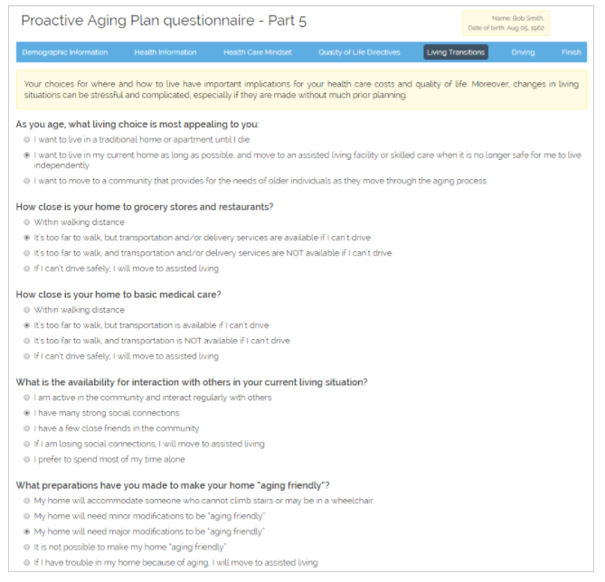
Whealthcare Proactive Aging Plan Questionnaire

Slide 33
Whealthcare Proactive Aging Plan Report
Provides a report on your goals
Creates a task list of what is needed to realize those goals

Slide 34
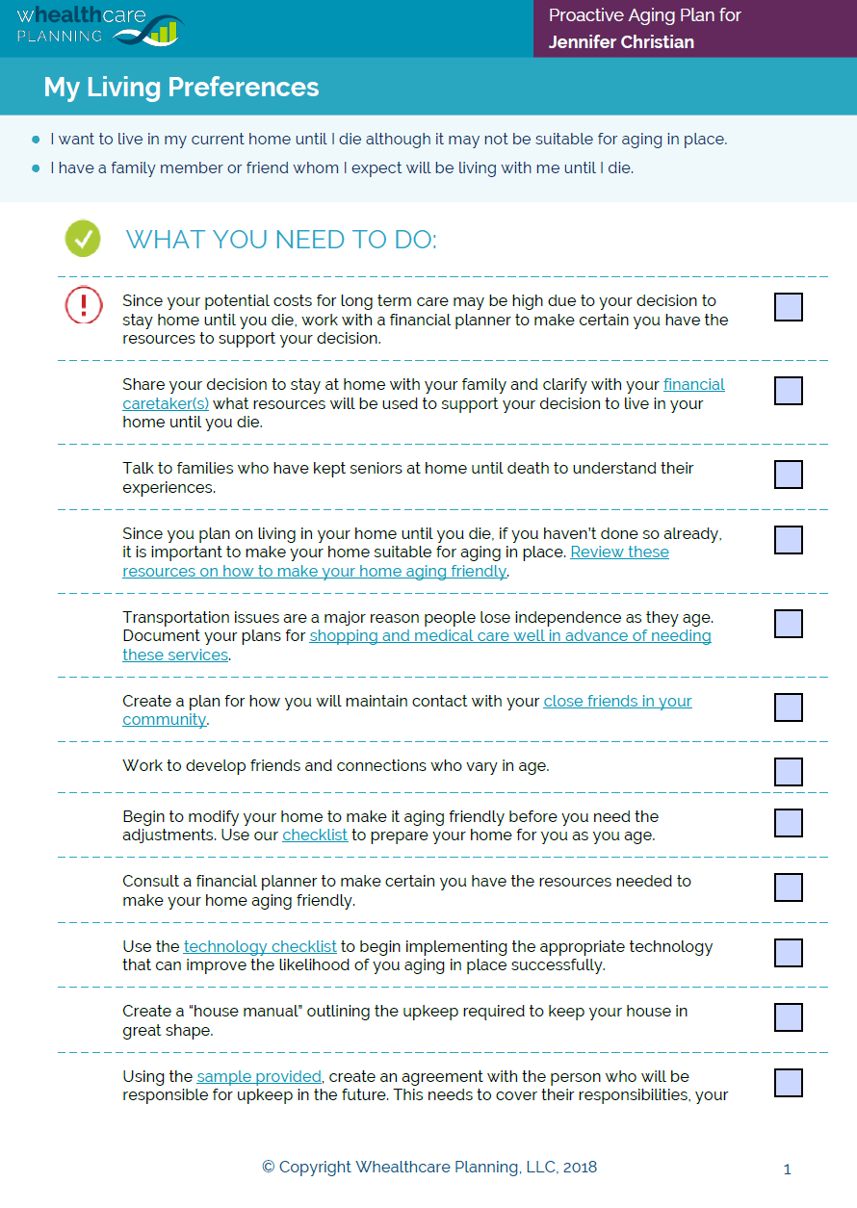
Whealthcare Proactive Aging Plan Report

Slide 35
Whealthcare Proactive Aging Plan Report
Estimates life expectancy, health care and long term care costs
Provides a quality of life directive for your family to use in making health care decisions

Slide 36
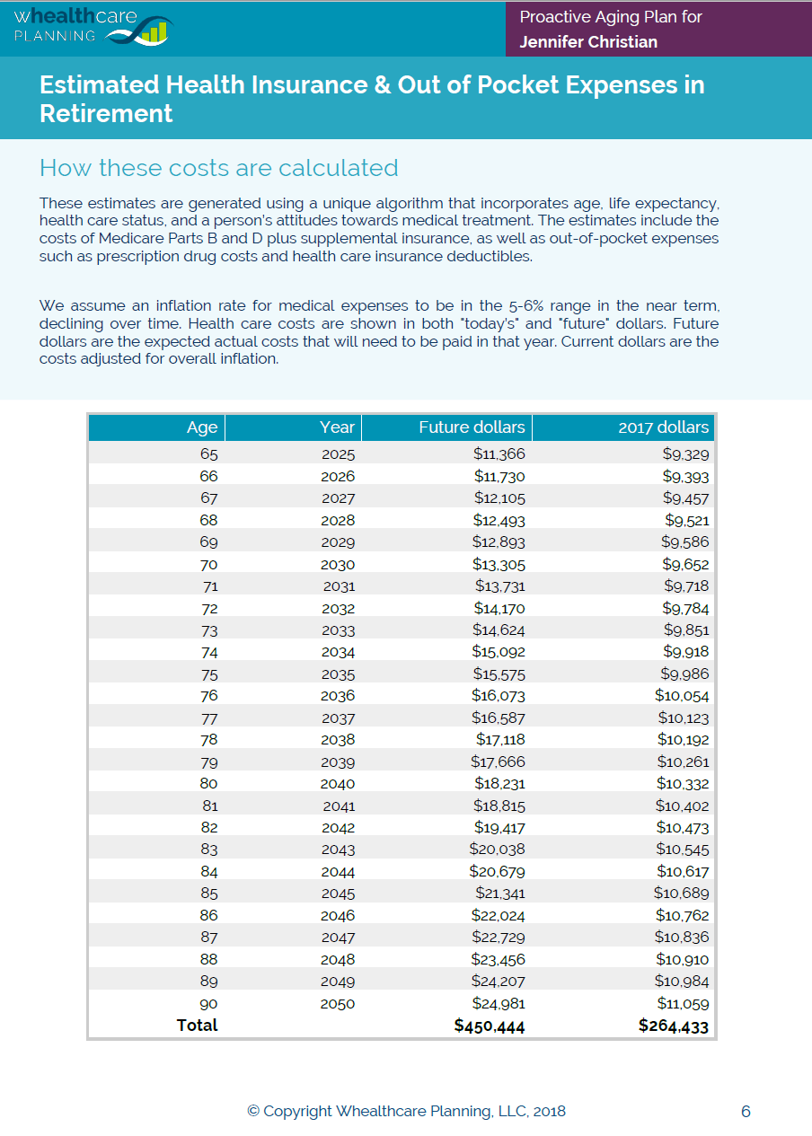
Health Care Costs

Slide 37
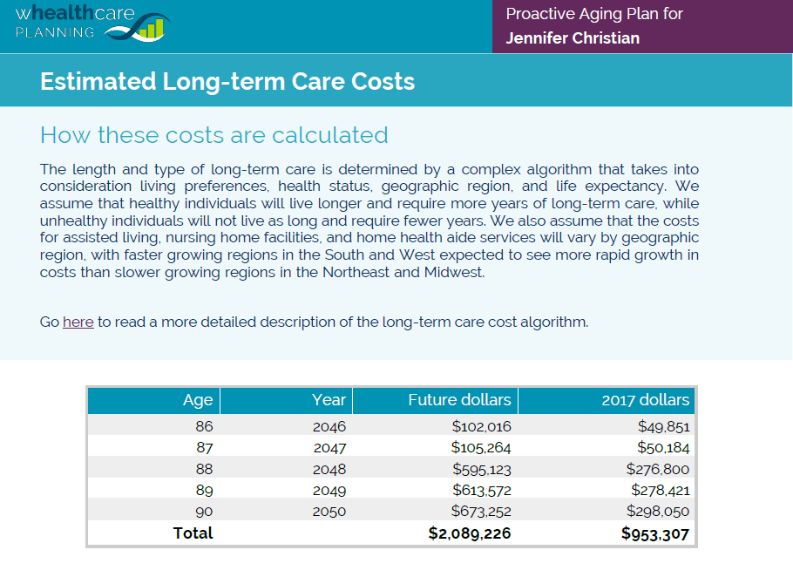
Long-term Care Costs

Slide 38
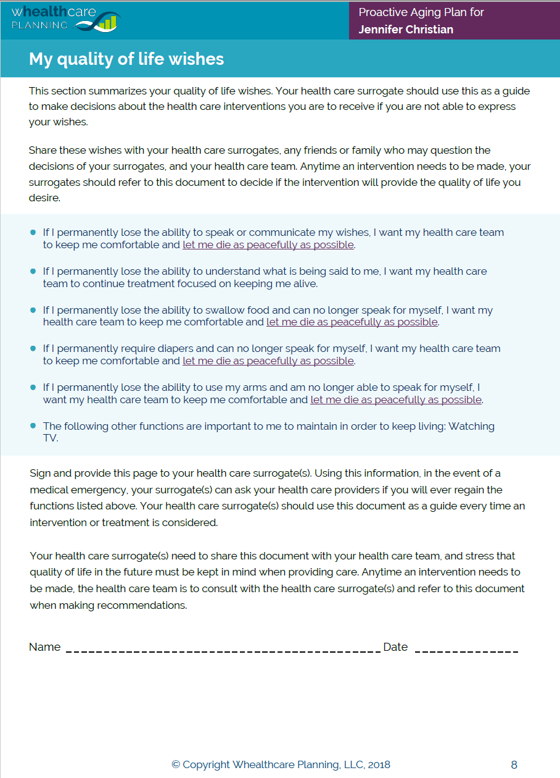
Quality of Life Directives

Slide 39
Summary

Slide 40
Transitions and Questionnaires Summary
Financial Decision-making
Health Care Decision-making
Living
Driving
Financial Caretaking Plan
Whealthcare Risk Profile
Proactive Aging Plan

Slide 41
Next Steps
We’ll send you a link to take the questionnaires
Once you complete the questionnaires, we get a notice you are done
After we review the reports, we’ll share them with you and set a meeting to follow up

Slide 42
Questions?

